Slide 1

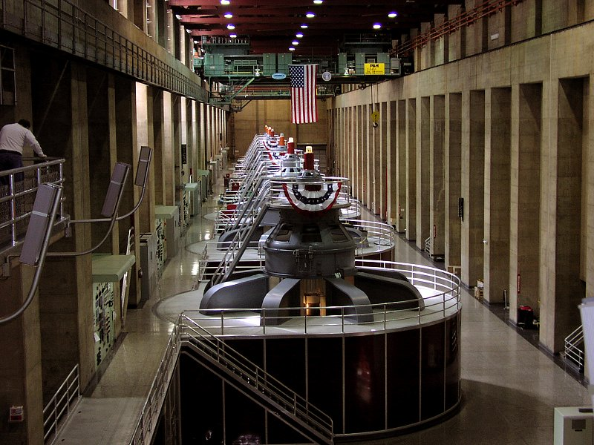
Inducing e.m.f and Current Generators and Transformers

Slide 2


Faradays Law Lenz’s Law Review
Generators
Transformers

Slide 3

Review – Some Important Laws
What can you remember about….
Faradays Law?
Lenz’s Law?

Slide 4
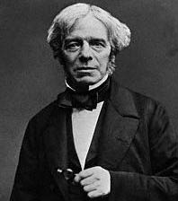
Faraday’s law
The induced e.m.f. is equal to the rate of change of magnetic flux,
e.m.f = -ΔФ
Δt

Slide 5
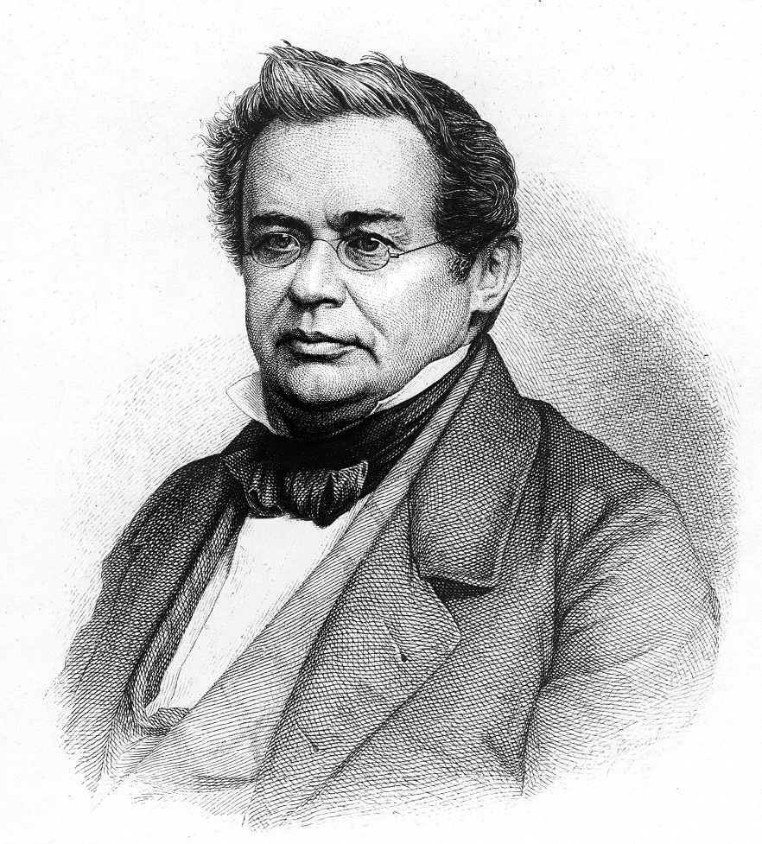
Lenz’s Law
If an induced current flows, its direction is always such that it will oppose the change which produced it
Heinrich Lenz 1833

Slide 6
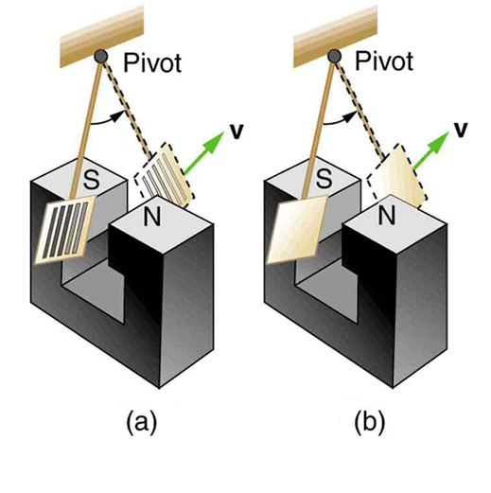
Eddy Currents - Demo
Two metal plates are setup on a pendulum as shown. Both are the same size and square, but one plate has grills cut through it.
Predict the outcome as both are swung through the magnetic field.

Slide 7
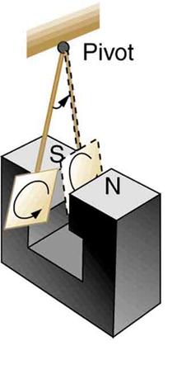
Eddy Currents - Demo
The square plate swings through the field but is slowed by an induced current as explained by Lenz’s law.
We refer to that current as an eddy current. Eddy currents can produce significant drag, called magnetic damping, on the motion involved.
Another important fact about eddy currents is that they produce heat and result in energy loss.

Slide 8
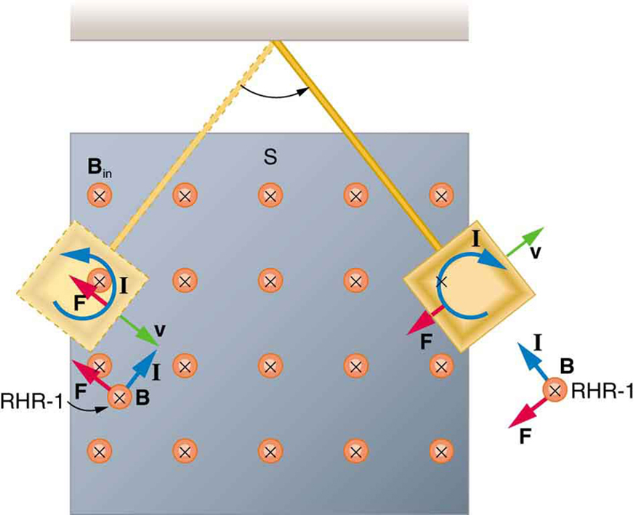
Eddy Currents - Demo
The direction of the eddy currents depends on whether the plate is swinging into or out of the magnetic field.
When the plate is swinging into the field a repulsive force is produced by the induced current.
When the plate is swinging out of the field an attractive force is produced by the induced current.

Slide 9
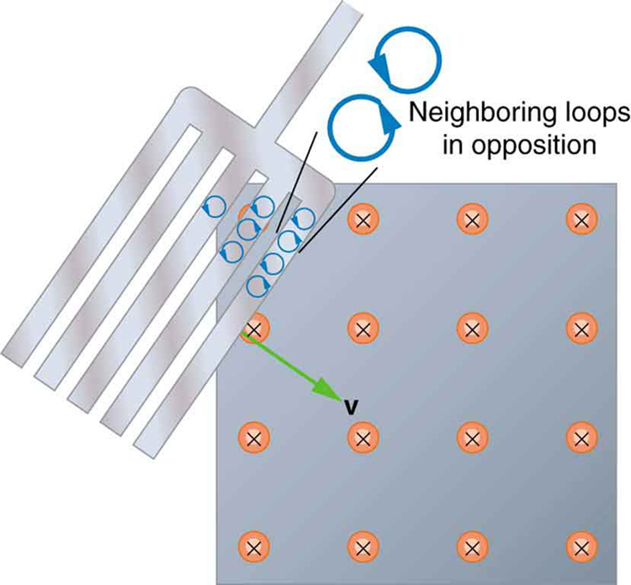
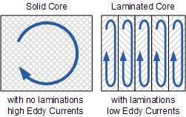
Eddy Currents - Demo
The cut plate swings through the field with less dampening because the eddy currents formed are restricted in size by the forks of the conductor.
Furthermore, the individual eddy currents partially cancel each other out where fields of two eddy currents are in opposite directions.

Slide 10
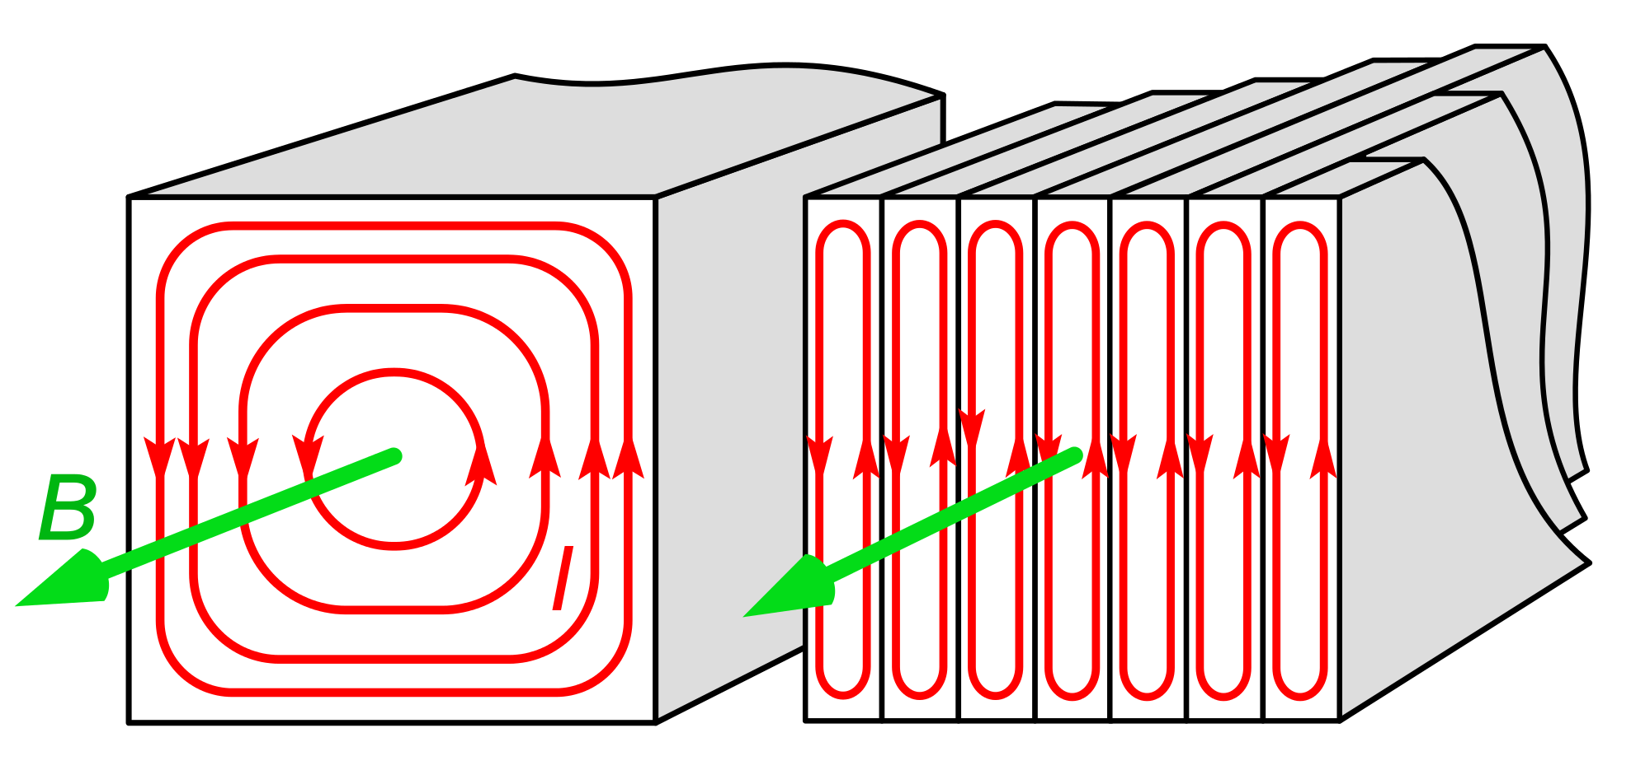
Laminated Iron – Recues Eddy Current Effects

Slide 11
Review Question
Identical magnets A and B are suspended above vertical copper tubes as shown in the diagram
The magnets are dropped at the same time. Each magnet falls straight through its tube without touching the tube walls.
Which magnet leaves its tube first and why?

Slide 12
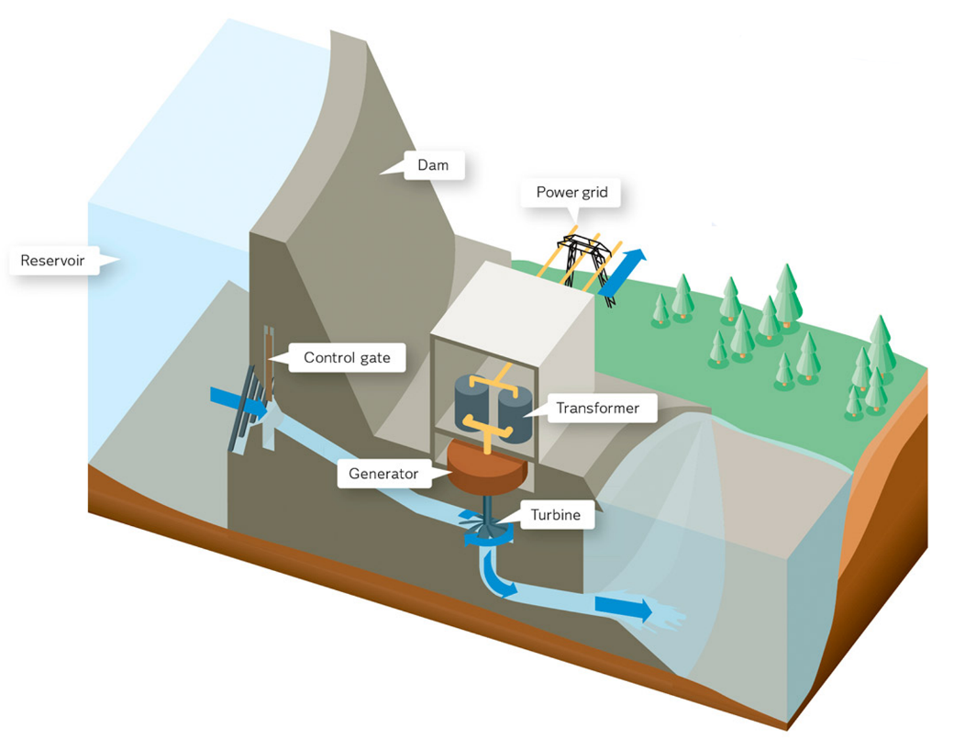
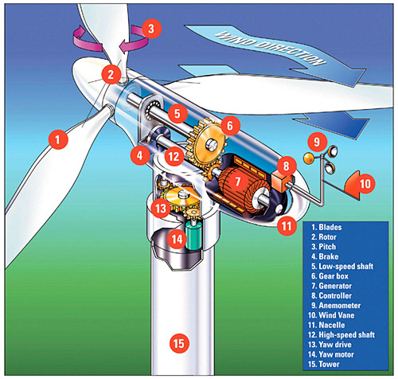
Alternating Current Generators
Most electricity is produced using the ‘generator effect’.
This includes:
Coal and gas power,
Nuclear power
Hydroelectric power,
Wind power etc….
The simplest generators and the types used in power stations produce alternating current (A.C.)

Slide 13
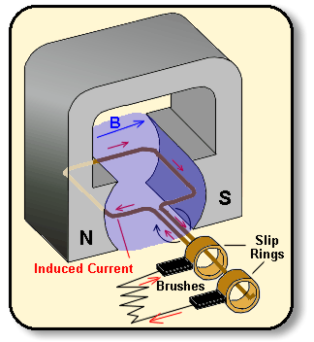
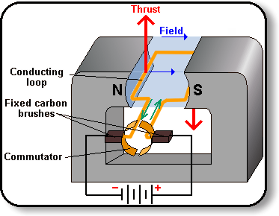
Motor = Generator
If electric energy enters a motor it is changed into kinetic energy, but if kinetic energy is input (the motor is turned) electric energy is produced!

Slide 14
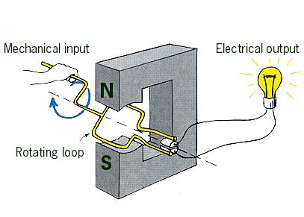
Generator/dynamo
A generator works in this way by rotating a coil in a magnetic field (or rotating a magnet in a coil)

Slide 15
Alternating current
A coil rotated in a magnetic field will produce an e.m.f.
N
S

Slide 16
Alternating current
In the vertical position, the plane of the coil is perpendicular to the field, therefore it will cut maximum flux according to .
Ф = BA cosθ
N
S

Slide 17
Alternating current
In the horizontal position, the plane of the coil is parallel to the field, therefore it will cut ZERO flux according to .
Ф = BA cosθ
N
S

Slide 18
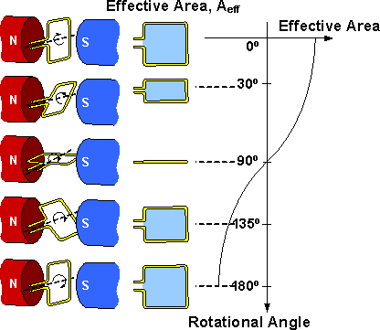
Alternating current
As the coil spins, the effective area that is perpendicular to the field lines is reduced according to a cosine function.
This also means that the rate at which the area changes is not constant (linear) and therefore e.m.f. is not constant. (Faraday’s Law)

Slide 19
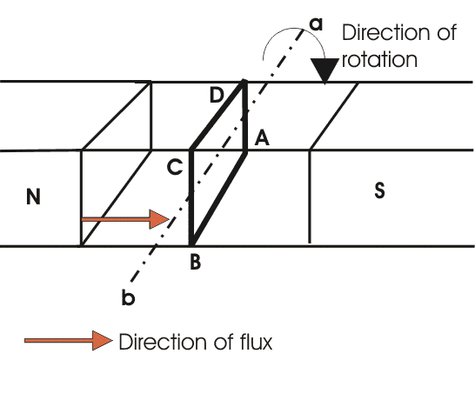
Alternating current
In the vertical position the flux cut by the coil is maximum.
Motion however is parallel to the field so current and e.m.f induced is ZERO.
e.m.f = lvB ┴

Slide 20
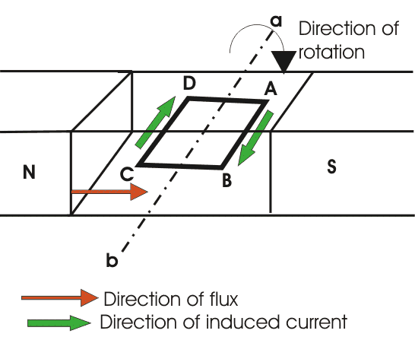
Alternating current
In the horizontal position the flux cut by the coil is ZERO.
Motion however is perpendicular to the field so e.m.f induced is maximum.
e.m.f = lvB ┴
USE YOUR HAND RULES TO CHECK THAT CURRENT DIRECTION IS CORRECT

Slide 21
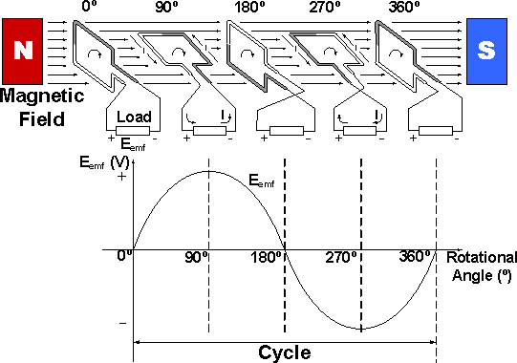
Alternating current
At points in-between horizontal and vertical, the component of velocity perpendicular to the field decreases.
This means induced e.m.f. decreases too.
e.m.f = lvb

Slide 22
Alternating current
The e.m.f. produced is sinusoidal (for constant rotation)
e.m.f.
V

Slide 23
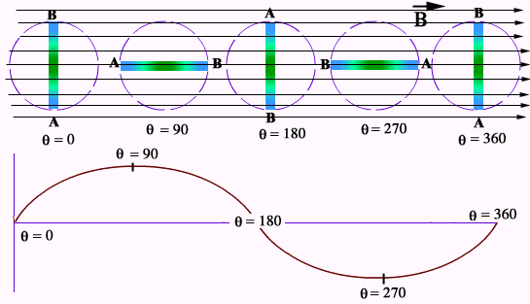
ZERO area and FLUX
MAX e.m.f.
MAX area and FLUX
ZERO e.m.f.

Slide 24
Slip ring commutator
To use this e.m.f. to produce a current the coil must be connected to an external circuit using either a slip ring commutator (shown below) or a split ring commutator (like a motors).
Slip-rings
lamp

Slide 25
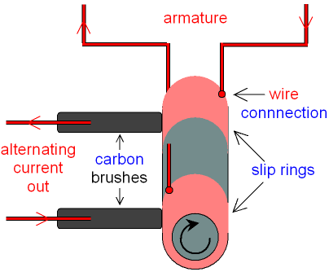
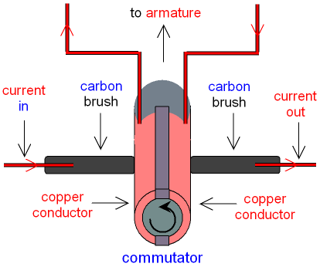
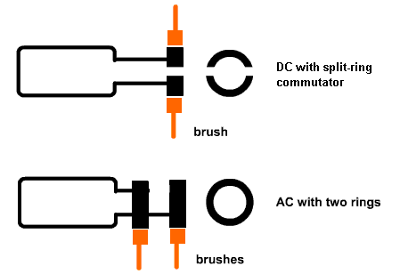
Slip Ring Commutator vs. Split Ring Commutator
A slip ring commutator will
Result in AC current output.
A split ring commutator will
Result in DC current output
(discussed later).

Slide 26
What happens if the frequency or rate of rotation is doubled?
What did that Faraday guy say again?
e.m.f.
V

Slide 27
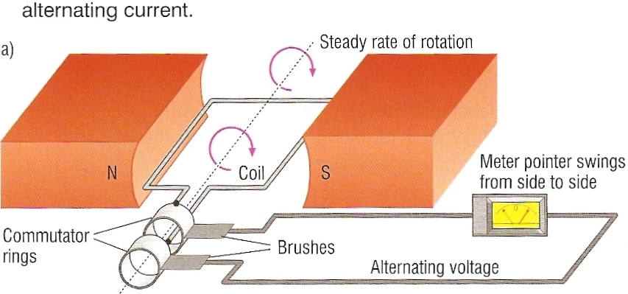
Moving Coil A.C. Generator
Daw arrows in to show the direction of current flow at this moment in both the coil and the wires leading to the meter.

Slide 28
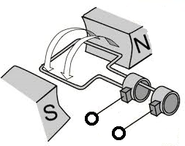
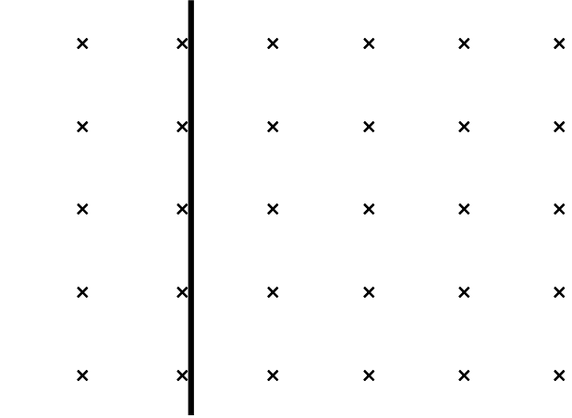
Review: Which terminal / end is positive at this moment in time?

Slide 29
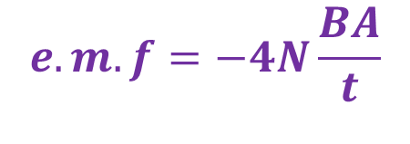
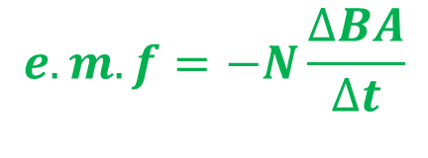
AC Generator Calculations – Average e.m.f.
A coil with an Area A and a number of turns N rotating with a frequency of f will have a change in flux of BA in one quarter of a full rotation. (this is from zero to maximum flux BA).
In a full rotation it will do this change 4 times, thus….
$$e.m.f=−N\frac{∆BA}{∆t}$$
You can use this if you know the time for one quarter of a rotation
$$e.m.f=−4N\frac{BA}{t}$$
You can use this if you know the time of one complete rotation (period)

Slide 30

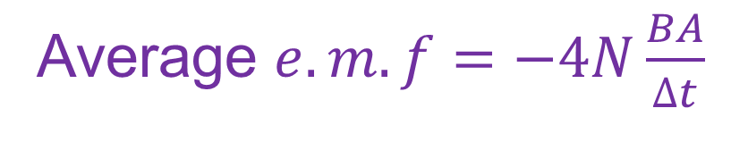
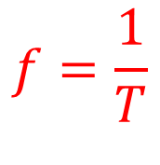
AC Generator Calculations – Average e.m.f.
Often information about generators states frequency of rotation instead of time as these are often very fast..
In which case we need to remember that
Average $e.m.f=−4N\frac{BA}{∆t}$
$$f=\frac{1}{T}$$
Average $e.m.f=−4N BA f$

Slide 31
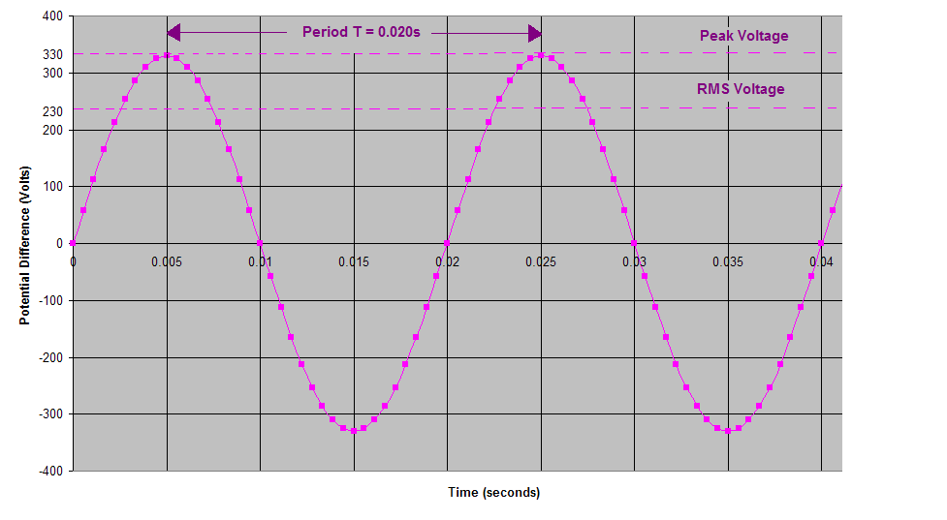
AC Generator Calculations – PEAK or MAX e.m.f.
As can be seen from the graph, the e.m.f. induced varies significantly with time. Our power supply is rated at 240V but in fact has much higher voltages at the crests of the curves. The maximum e.m.f. can be calculated using the position where velocity perpendicular to the field is at its maximum.
Where is in a rotation is that?

Slide 32
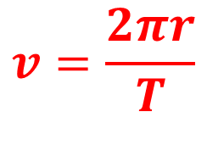


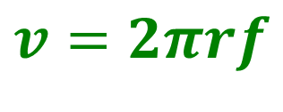
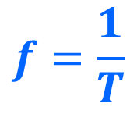
AC Generator Calculations – PEAK or MAX e.m.f.
Since the coil is rotation through a circle,
the distance covered in one rotation is equal to the circumference, and therefore the velocity is equal to
and therefore
L
r
$$v=\frac{2πr}{T}$$
$$f=\frac{1}{T}$$
$$v=2πrf$$
$$e.m.f=lvB$$
$$e.m.f=l 2πrf B$$

Slide 33


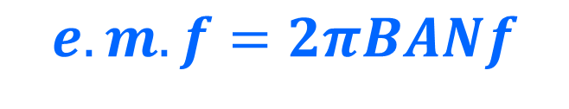


AC Generator Calculations – PEAK or MAX e.m.f.
$$e.m.f=l 2πrf B$$
L
r
But 2r = Diameter (which is the width of the coil) .
and Length x Diameter = Area of the coil so….(for each side)
Considering both sides and the number of turns the maximum e.m.f. becomes…
$$e.m.f=πBAf$$
$$e.m.f=2πBANf$$

Slide 34
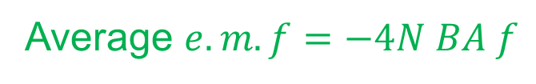
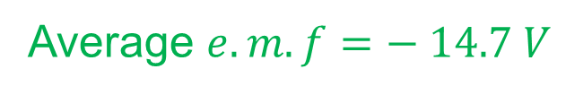
Example 1
A coil with 120 turns measures 12.0 cm by 8.50 cm and rotates at 1200 rpm through a field of 0.150 T. What is the average e.m.f. that is generated?
F = 1200rpm
= 20 Hz
N = 120
A = 0.120 x 0.0850
= 0.0102 m²
B = 0.150 T
Average $e.m.f=−4N BA f$
Average $e.m.f=−4x 120 x 0.150 x 0. 0102 x 20$
Average $e.m.f=− 14.7 V$
Voltage varies between positive and negative e.m.f
so we usually drop the negative sign.

Slide 35


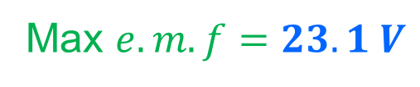
Example 2
A coil with 120 turns measures 12.0 cm by 8.50 cm and rotates at 1200 rpm through a field of 0.150 T. What is the Maximum e.m.f. that is generated?
F = 1200rpm
= 20 Hz
N = 120
A = 0.120 x 0.0850
= 0.0102 m²
B = 0.150 T
Max $e.m.f=2πBANf$
Max $e.m.f=2πx 0.150 x 0.0102 x 120x 20$
Max $e.m.f=23.1 V$
Voltage varies between positive and negative e.m.f
so we usually drop the negative sign.

Slide 36
Root mean square voltage and current
It is useful to define an “average” current and voltage when talking about an a.c. supply.
Unfortunately, the average voltage and current is zero!
To help us we use the idea of root mean square voltage and current.

Slide 37
Root mean square voltage
e.m.f.
V

Slide 38
Root mean square voltage
First we square the voltage to get a quantity that is positive during a whole cycle.
e.m.f.
V

Slide 39
Root mean square voltage
Then we find the average of this positive quantity
e.m.f.
V

Slide 40
Root mean square voltage
We then find the square root of this quantity.
e.m.f.
V

Slide 41
Root mean square voltage
We then find the square root of this quantity.
e.m.f.
V
This value is called the root mean square voltage

Slide 42
Root mean square voltage
We then find the square root of this quantity.
e.m.f.
V
E_{max}
E_{rms} = E_{max}
√2

Slide 43
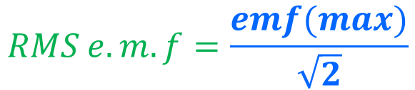
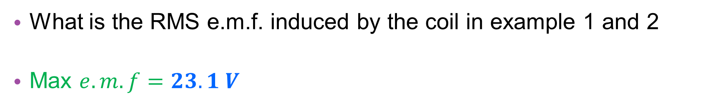
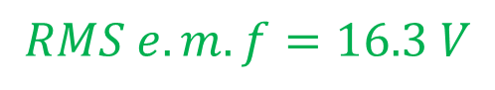
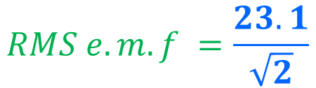
Example 3
What is the RMS e.m.f. induced by the coil in example 1 and 2
Max $e.m.f=23.1 V$
$$RMS e.m.f=\frac{emf(max)}{\sqrt{2}}$$
$$RMS e.m.f =\frac{23.1}{\sqrt{2}}$$
$$RMS e.m.f=16.3 V$$

Slide 44
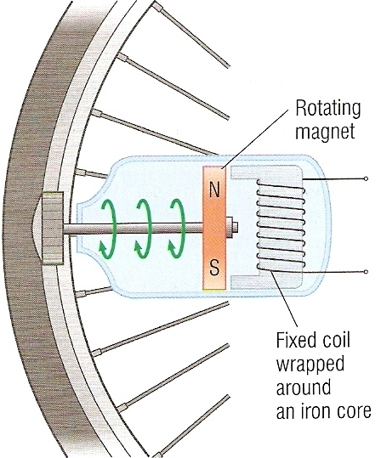
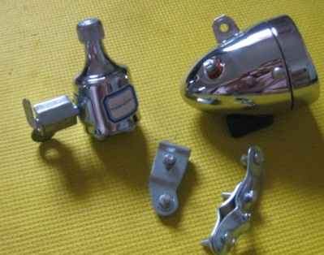
Bicycle generator
When the wheel turns the magnet is made to rotate next to the fixed coil of wire.
Electromagnetic induction occurs and a alternating voltage is induced in the coil.
This causes an alternating current to flow to the light bulb of the bicycle.

Slide 45
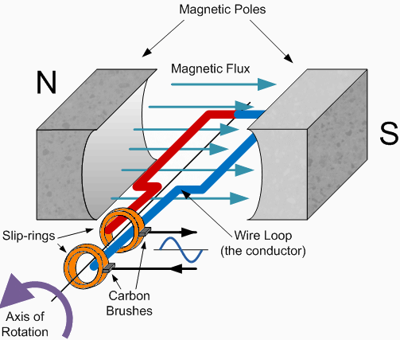
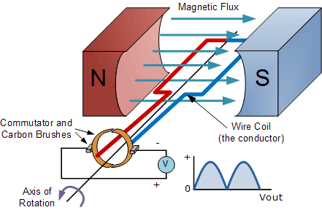
DC Generator

Slide 46
Review Question
V
The graph opposite shows how the voltage of an AC generator varies in time.
Describe or draw show how the voltage would vary if …..
Rotational frequency is halved
Area of the coil in the field is doubled
A split ring commutator was used instead of a slip ring commutator.
time

Slide 47
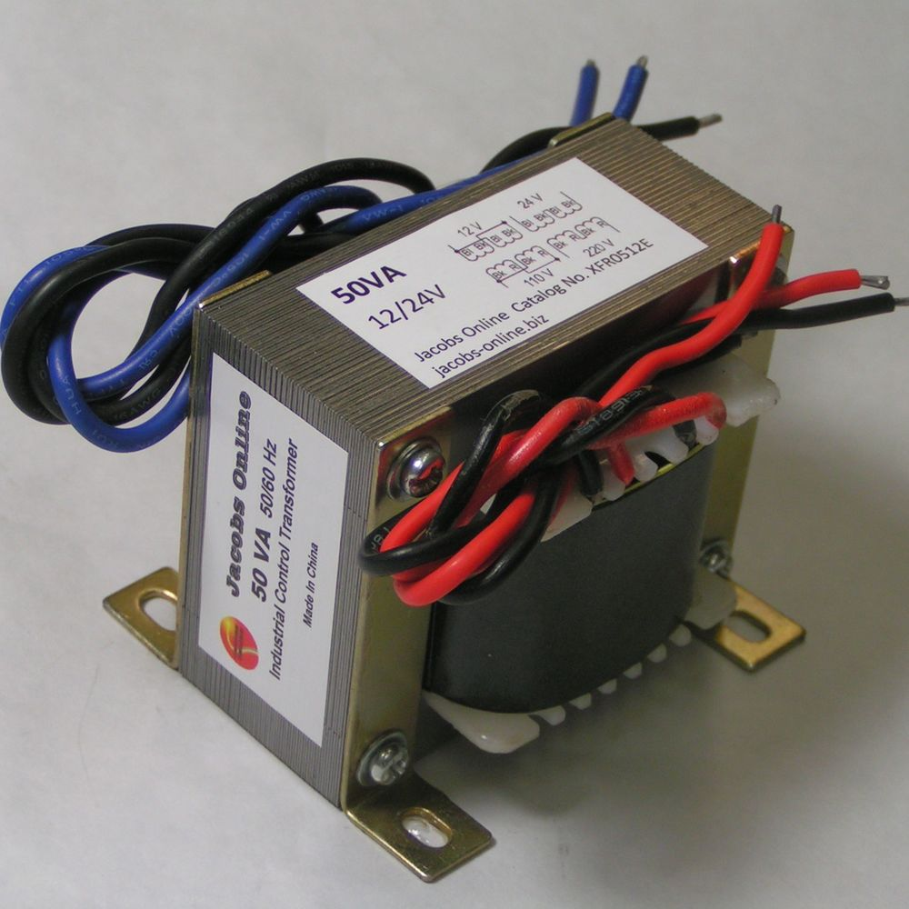
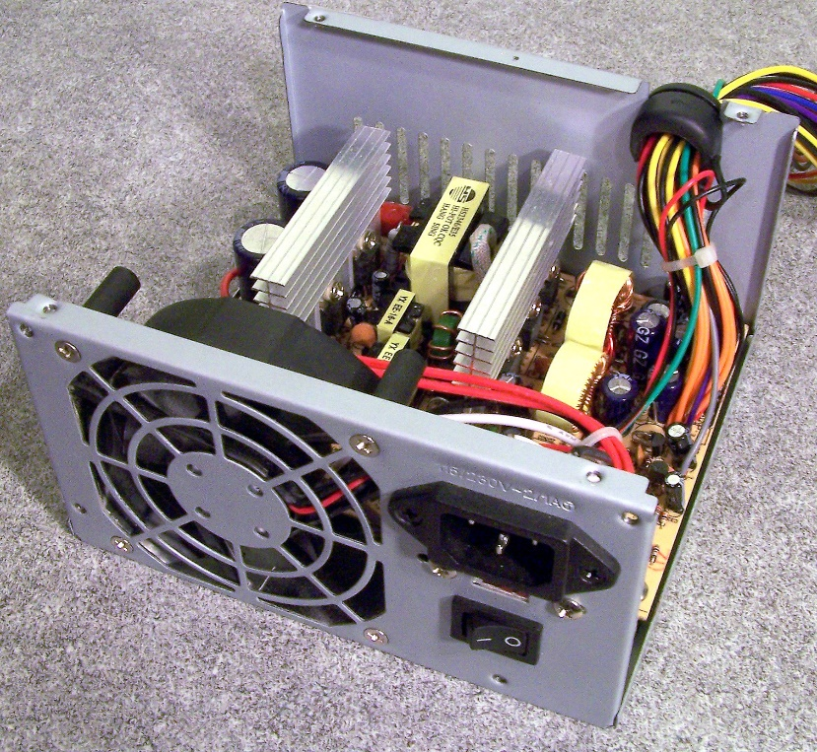
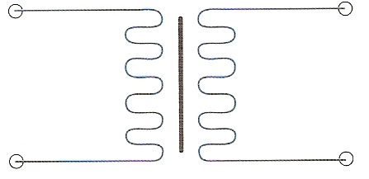
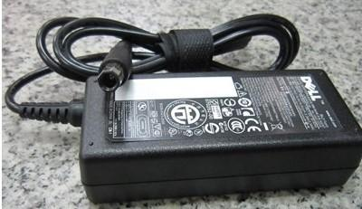
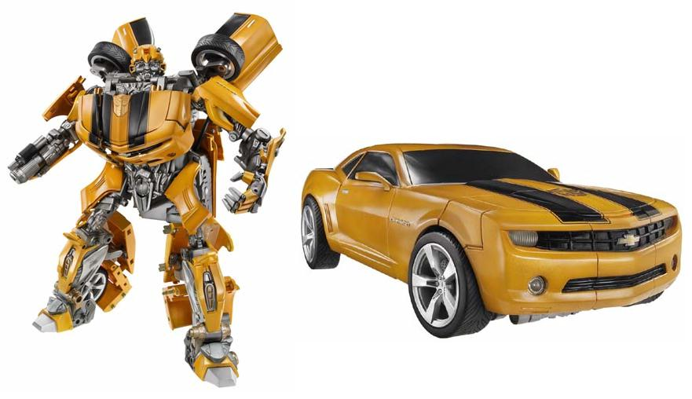
The transformer
A transformer is a device that is used to change one alternating voltage level to another.
circuit symbol

Slide 48
Structure of a transformer
A transformer consists of at least two coils of wire wrapped around a laminated iron core.
PRIMARY COIL of N_{p} turns
SECONDARY COIL of N_{s} turns
PRIMARY VOLTAGE V_{p}
SECONDARY VOLTAGE V_{s}
laminated iron core

Slide 49

Mutual inductance
growing B-field due to induced I in secondary coil
Explanation:
induced I opposes the build-up of
B-field
primary coil
secondary coil
B-field ‘cuts’ in secondary coil
B-field due to growing primary I
(like an approaching magnet)

Slide 50
Mutual inductance
B-field ↓ to 0 as
secondary I ↓ to 0
primary coil
secondary coil
steady B-field
⇒ no induced voltage
⇒ secondary I ↓ to 0
steady B-field due to steady primary I

Slide 51
Mutual inductance
When the switch is open…
B-field collapses when primary I is absent

Slide 52
Mutual inductance
By Lenz’s
Law
tries to oppose the retreat of the B-field
B-field due to induced I in secondary coil
B-field collapses when primary I is absent

Slide 53
Mutual inductance
B-field due to induced I in secondary coil collapses
Lastly, no B-field from primary I

Slide 54
Mutual inductance

Slide 55
Explaining How a transformer works
When an alternating voltage, V_{p} is applied to the primary coil of N_{p} turns it causes an alternating current to flow in this coil.
This current causes a changing magnetic field in the laminated iron core which cuts across the secondary coil of N_{s} turns.
Electromagnetic induction occurs in the secondary coil due to the change in flux.
As the current direction in the primary coil reverses, so does the flux and…
this results in alternating current / voltage, V_{s} in the secondary coil so that the direction always opposes the change in flux.

Slide 56


Step-up transformers
In a step-up transformer the voltage across the secondary coil is greater than the voltage across the primary coil.
The secondary turns must be greater than the primary turns.
Use: To increase the voltage output from a power station from 25 kV (25 000 V) to up to 400 kV.

Slide 57


Step-down transformers
In a step-down transformer the voltage across the secondary coil is smaller than the voltage across the primary coil.
The number of secondary turns must be smaller than the primary turns.
Use: To decrease the voltage output from the mains supply from 230V to 5V to power and recharge a mobile phone.

Slide 58

Review Question
Why can a transformer not change the level of the voltage output of a battery?
A battery has a constant potential difference causing current to flow in one direction only.
This current would produce a stable magnetic field in the iron core.
This would therefore NOT cause electromagnetic induction in the secondary coil as there is no change in flux (Faraday’s Law).
There would therefore be no secondary current or voltage.

Slide 59

The transformer equation
The voltages or potential differences across the primary and secondary coils of a transformer are related by the equation:
primary voltage = primary turns
secondary voltage secondary turns
V_{p} = N_{p}
V_{s} N_{s}

Slide 60

Example 1
Calculate the secondary voltage of a transformer that has a primary coil of 1200 turns and a secondary of 150 turns if the primary is supplied with 230V.
Vp = Np
Vs Ns
230 / V_{s} = 1200 / 150
230 / V_{s} = 8
230 = 8 x V_{s}
230 / 8 = V_{s}
Secondary voltage = 28.8 V

Slide 61

Example 2
Calculate the number of turns required for the primary coil of a transformer if secondary has 400 turns and the primary voltage is stepped up from 12V to a secondary voltage of 48V.
Vp = Np
Vs Ns
12 / 48 = N_{p} / 400
0.25 = N_{p} / 400
0.25 x 400 = N_{p}
Primary has 100 turns

Slide 62
Complete:
Answers
PRIMARY |  | SECONDARY
Voltage | Turns | Voltage | Turns
230 V | 1000 | 11.5 V | 50
230 V | 500 | 46 V | 100
230 V | 200 | 920 V | 800
9 V | 120 | 72 V | 960
50
46 V
200
9 V

Slide 63

Transformer power transfer equation
If a transformer is 100% efficient then the power input to the primary coil is equalled by the power output from the secondary coil.
as power = current x voltage P = VI
Power Input = Power Output
then:
I_{p} x V_{p} = I_{s} x V_{s}

Slide 64
Example 3
Calculate the primary current when a transformer is supplied with 230V the secondary provides 4A at a voltage of 13V. Assume that the transformer is 100% efficient.
I_{p} x V_{p} = I_{s} x V_{s}
I_{p} x 230V = 4A x 13V
I_{p} = 52 / 230
Primary current = 0.226 A

Slide 65
Example 4
Calculate the secondary current from a transformer supplying a secondary voltage of 6V if the primary is supplied with a current of 0.20A at 230V. Assume that the transformer is only 95% efficient.
P_{p} x 95% = P_{s}
I_{p} x V_{p} x 0.95 = I_{s} x V_{s}
0.2A x 230V x 0.95 = I_{s} x 6V
I_{s} = 43.7 / 6
Secondary current = 7.28 A

Slide 66
Complete:
Answers
PRIMARY |  |  | SECONDARY
Np | Vp | Ip | Ns | Vp | Is
600 | 200V | 0.4 A | 30 | 10V | 8 A
100 | 12V | 8 A | 4000 | 480V | 0.2 A
300 | 72V | 0.4 A | 50 | 12V | 2.4 A
50 | 25V | 10 A | 250 | 125V | 2 A
1
2
3
4
6
5
8
7

Slide 67

Power transmission
At power stations the output voltage of the generators is stepped up by transformers from 25kV to 132kV.
The voltage may be further increased to up to 400 kV for transmission over long distance pylon lines.

Slide 68

Power transmission
The voltage is reduced in stages by step-down transformers to different levels for different types of consumer.
The lowest level is 230-240V for domestic use. The final step-down transformer will be at sub station within a few hundred metres of each group of houses.

Slide 69
Why do we Step up and Step down Voltage for Power transmission?
The higher the voltage used, the greater the efficiency of energy transmission is. (i.e less energy loss). Thus we step up voltage for transfer of power over long distances.
240 V
Step-down
250,000 V
11,000 V
Step-up
Step-down
15,000 V

Slide 70
Why do we Step up and Step down Voltage for Power transmission?
Lower voltages result in higher electric currents and greater energy loss to heat due to the resistance of the cables.
240 V
Step-down
250,000 V
11,000 V
Step-up
Step-down
15,000 V

Slide 71
Why do we Step up and Step down Voltage for Power transmission?
Voltage is only reduced to low values when very close to the delivery point..
240 V
Step-down
250,000 V
11,000 V
Step-up
Step-down
15,000 V

Slide 72

Power transmission – Energy Loss Calculations
When current passes through a wire, the power dissipated (lost as heat or other energy types) is equal to
P = VI across the wire
Since V = IR
Power dissipated (loss) = I²R

Slide 73
Power transmission
Power dissipated = I²R
Since the loss of power depends on the square of the current, when transmitting energy over large distances it is important to keep the current as low as possible.
However, to transmit large quantities of energy we therefore must have a very high voltage.
Power = Work / Time

Slide 74











Power loss and Voltage Drop Example Calculations
300 MW of electricity is transmitted at 250 kV, along a 250 km long power line with resistance of 1.00 ohm.
What is the output voltage at the other end of the power line?
Calculate Current Flowing in Lines
Calculate Power Loss in Lines
Calculate Power Output at End of Line
$$P=VI$$
$$P=I^{2} R$$
$$P=300x{10}^{6}− 1 440 000 W$$
$$I=\frac{P}{V}$$
$$P={1200}^{2} x 1$$
$P=298 560 000$ W
Calculate Reduced Potential at end of Line
$$I=\frac{300 x {10}^{6}}{250 x {10}^{3}}$$
$$P(loss)=1 440 000 W$$
$$P=V I$$
How would these values change if the power was transmitted at 50 kV? Try the calculation now.
$$298 560 000=V x 1200$$
$$I=1200 A$$
$$V=248 800 V$$

